Slide 1


Slide 2
HIGH FREQUENCY RESPOSE
There are two parts to this analysis
Which Capacitances will come into play at high frequency
What will be the effect of these Capacitances

Slide 3
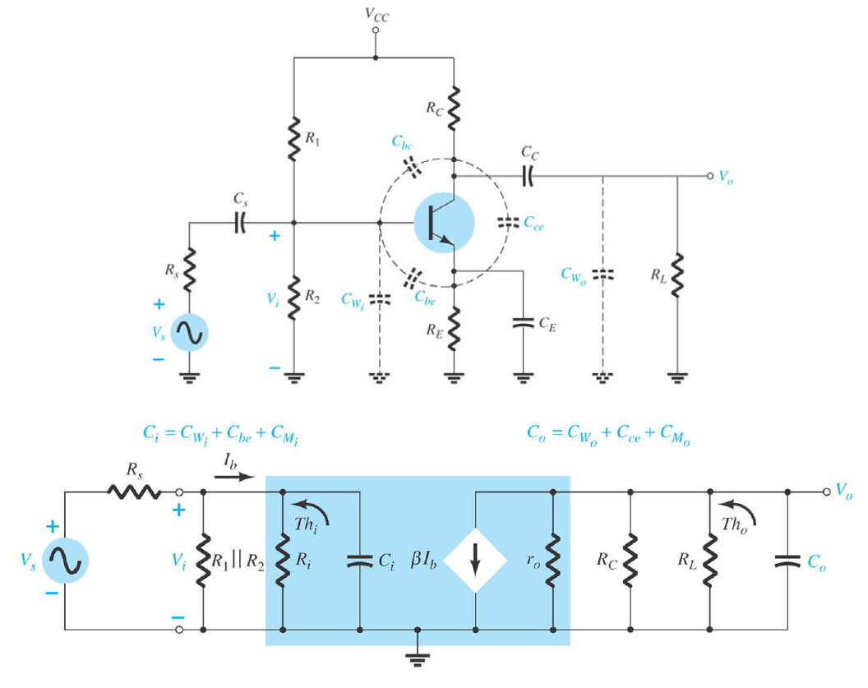
The total capacitances ; both external and internal for a BJT common emitter amplifier

Slide 4
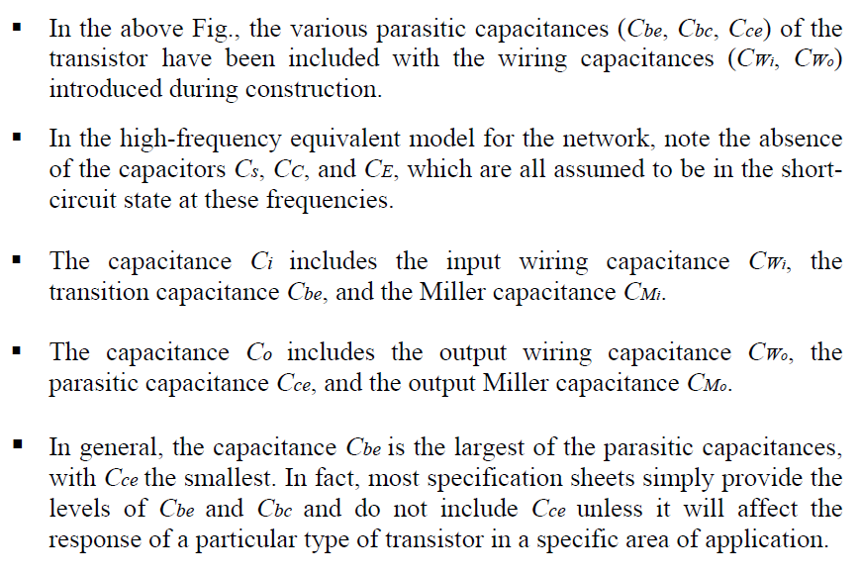

Slide 5
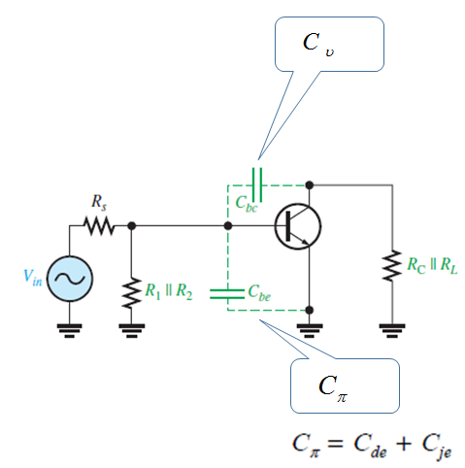
Types of internal Capacitances

Slide 6
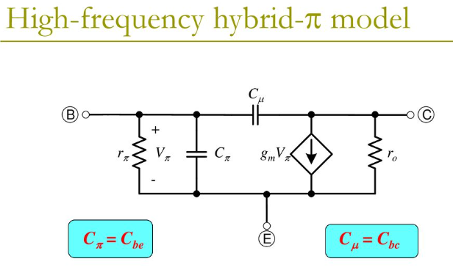
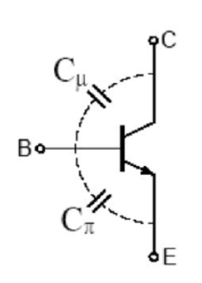

Slide 7
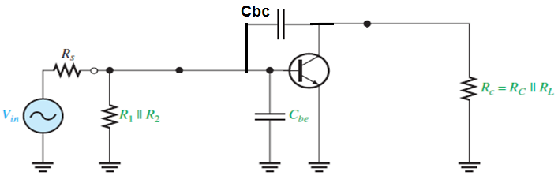
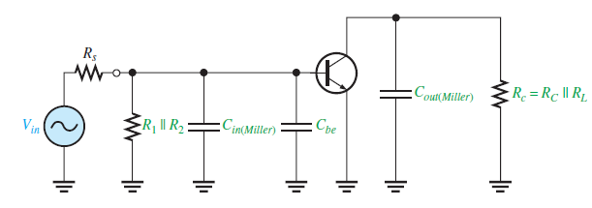
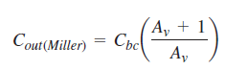
High-Frequency Analysis By applying Miller’s theorem
Looking in from the signal source, the capacitance Cbc appears in the Miller input capacitance from base to ground
Looking in at the collector, Cbc appears in the Miller output capacitance from collector to ground. the Miller output capacitance appears in parallel with Rc.

Slide 8
These two Miller capacitances create a high-frequency input RC circuit and a high frequency output RC circuit. These two circuits differ from the low-frequency input and output circuits, which act as high-pass filters, because the capacitances go to ground and therefore act as low-pass filters

Slide 9
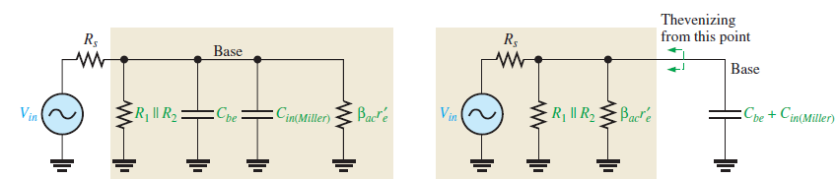
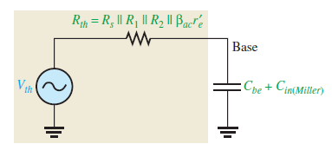
The Input RC Circuit
More Detailed analysis
As the frequency increases, the capacitive reactance becomes smaller. This causes the signal voltage at the base to decrease, so the amplifier’s voltage gain decreases. The reason for this is that the capacitance and resistance act as a voltage divider and, as the frequency increases, more voltage is dropped across the resistance and less across the capacitance. At the critical frequency, the gain is 3 dB less than its midrange value

Slide 10
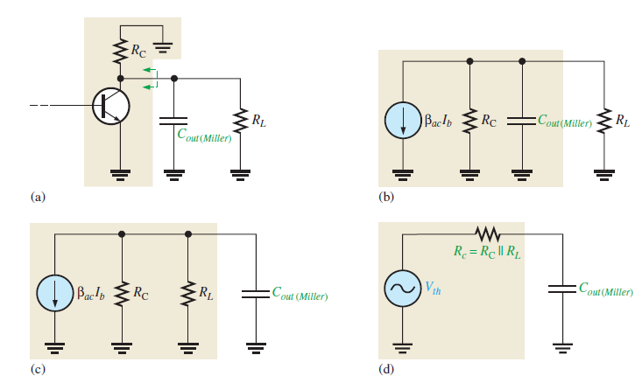

Slide 11
High Frequency Response of MOS Amplifier

Slide 12
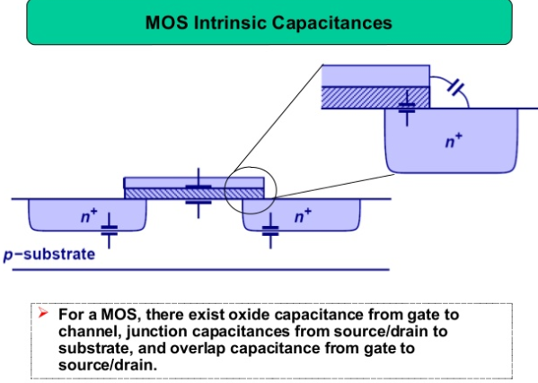

Slide 13
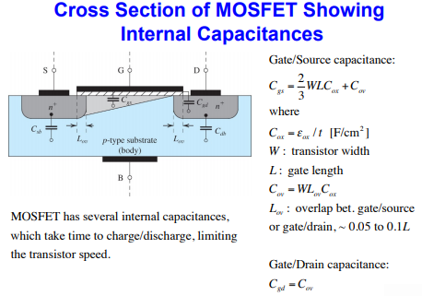

Slide 14
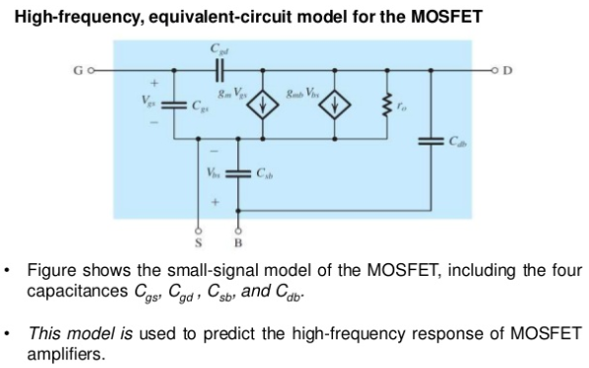

Slide 15
MOS Small signal Model
Simplified Model

Slide 16
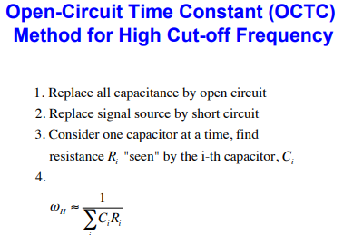

Slide 17
MOS High Frequency Response : Detailed analysis

Slide 18
1

Slide 19
2

Slide 20
2

Slide 21
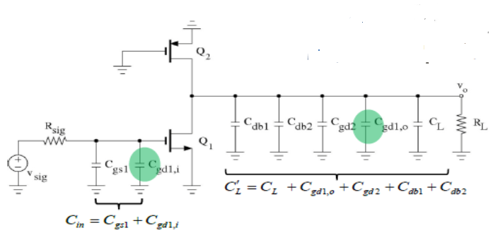
2

Slide 22
2

Slide 23
2

Slide 24
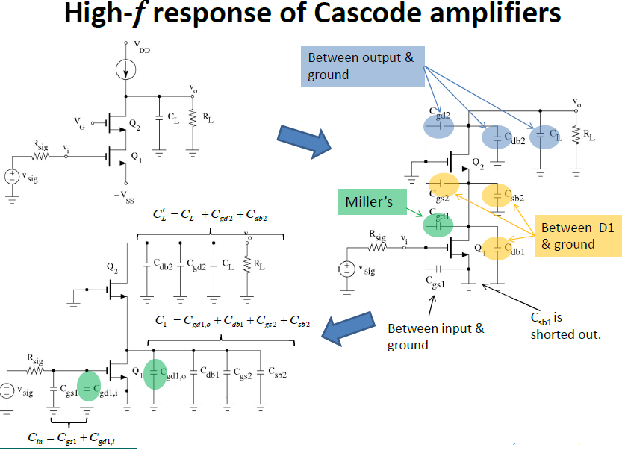
3

Slide 26
Frequency Response of Differential Amplifier

Slide 27
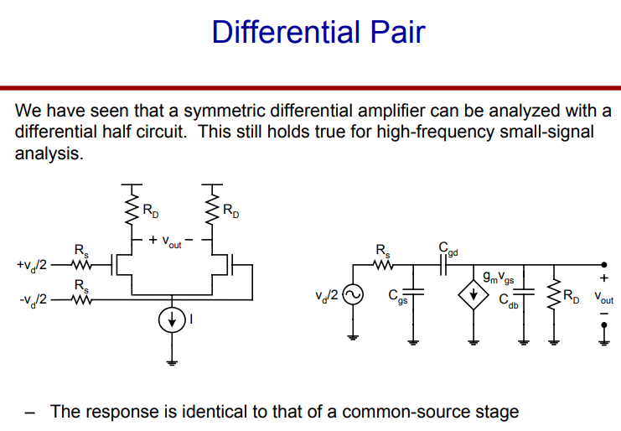

Slide 29
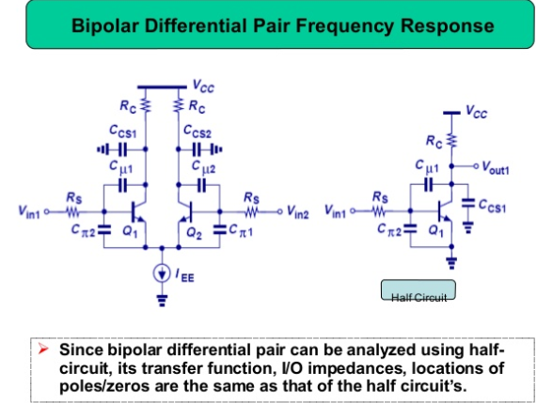

Slide 30
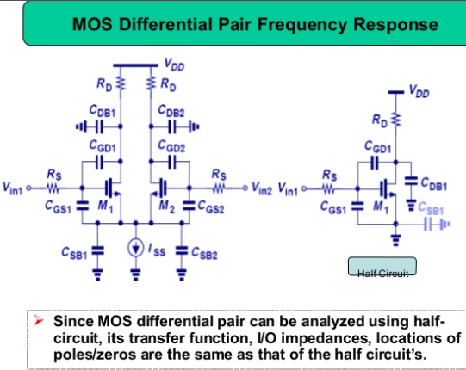

Slide 31
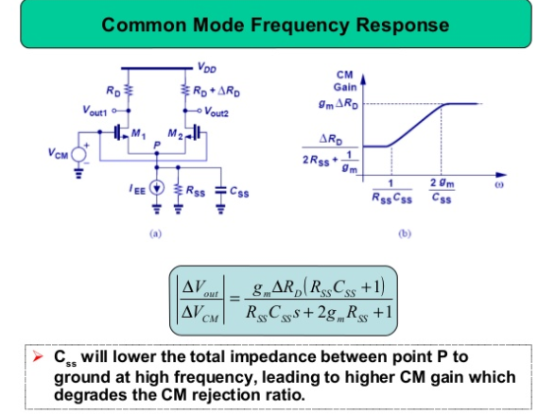

Slide 32
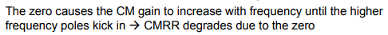

Slide 33
The MOSFET Unity-Gain Frequency (fT)
A figure of merit for the high-frequency operation of the MOSFET as an amplifier is the unity-gain frequency, fT, also known as the transition frequency, which gives rise to the subscript T.
This is defined as the frequency at which the short-circuit current-gain of the common-source configuration becomes unity

Slide 34
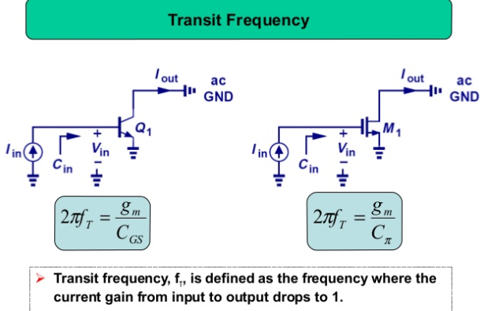

Slide 35
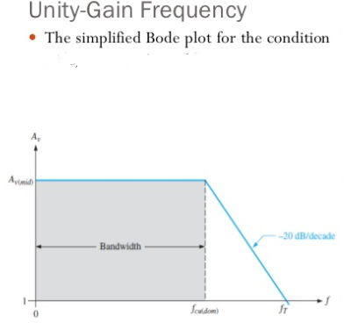

Slide 36
Operational Amplifier

Slide 37
Frequency Response of the Two-Stage CMOS Op Amp
C1 is the total capacitance at the interface between the first and second stages

Slide 38
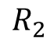
$$R_{2}$$
Is the output resistance of the second stage
C2 is the total capacitance at the output node of the op amp

Slide 41
Frequency Response of the Bipolar Op Amp

Slide 43
Multi-stage Amplifier

Slide 44
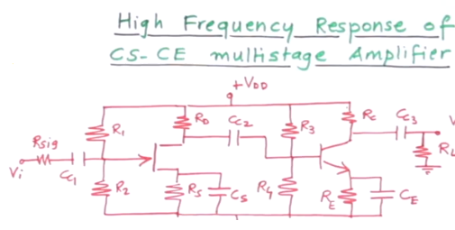

Slide 45
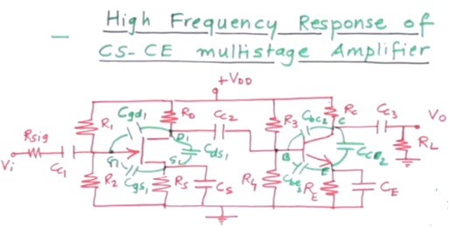

Slide 46
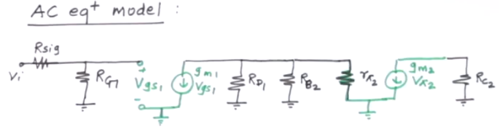
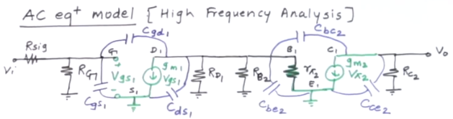

Slide 47
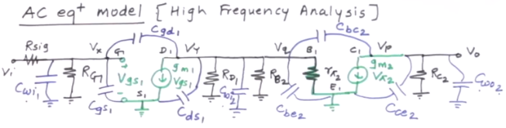
Wiring Capacitor
Wiring Capacitor
Wiring Capacitor

Slide 48
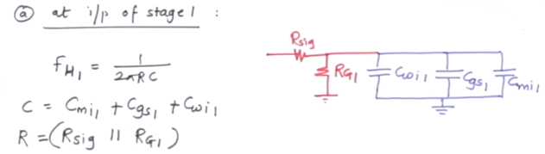
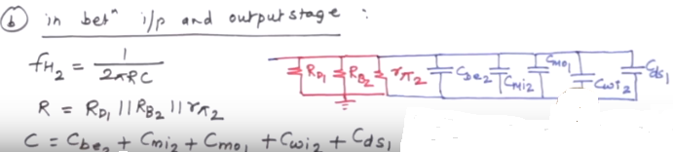
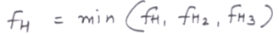
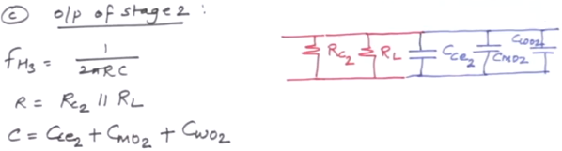
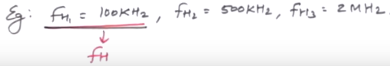

Slide 49
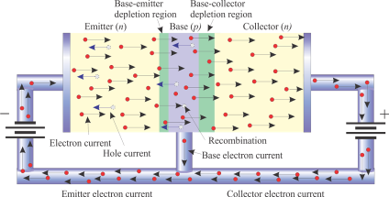
BJT FREQUENCY RESPONSE SUMMARY

Slide 50

Summary of BJT Frequency Response Analysis
Effect of Coupling Capacitors
Coupling capacitors are in series with the signal and are part of a high-pass filter network. They affect the low-frequency response of the amplifier.
The equivalent circuit for C₁ is a high-pass filter:
C₃ and (R_{C} + R_{L}) form another high-pass filter.

Slide 51
Summary of BJT Frequency Response Analysis
Effect of Bypass Capacitors
A bypass capacitor causes reduced gain at low-frequencies and has a high-pass filter response. The resistors “seen” by the bypass capacitor include R_{E}, r_{e}’, and the bias resistors.
The equivalent high-pass filter for C₂ is:
Question:
How would an emitter swamping resistor affect the response?
f_{c} would be lower due to increased R.

Slide 52
Summary of BJT Frequency Response Analysis
Internal Capacitances
The high-frequency response of an amplifier is determined by internal junction capacitances. These capacitances form low-pass filters with the external resistors.
Sometimes a designer will add an external parallel capacitor to deliberately reduce the high frequency response.

Slide 53
Summary of BJT Frequency Response Analysis
Miller’s Theorem
Miller’s theorem states that, for inverting amplifiers, the capacitance between the input and output is equivalent to separate input and output capacitances to ground.
A_{v} is the absolute value of the gain. For the input capacitance, the gain has a large effect on the equivalent capacitance, which is an important consideration when using inverting amplifiers.

Slide 54
Summary of BJT Frequency Response Analysis
Miller’s Theorem
Notice that the effect of Miller’s theorem is an equivalent capacitance to ground, which shunts high frequencies to ground and reduces the gain as frequency is increased.
Example:
What is the input capacitance for a 2N3904 inverting amplifier with a gain of 25? Assume the values of C_{bc} = 4 pF and C_{be} = 6 pF.
Solution:
C_{in} = C_{bc}(A_{v} + 1) + C_{be}
C_{in} = 4 pF(25 + 1) + 6 pF =
110 pF

Slide 55
Summary of BJT Frequency Response Analysis
The Decibel
The decibel is a logarithmic ratio of two power levels and is used in electronics work in gain or attenuation measurements. Decibels can be expressed as a voltage ratio when the voltages are measured in the same impedance.
To express power gain in decibels, the formula is
A_{p(dB)} = 10 log A_{p}
To express voltage gain in decibels, the formula is
A_{v(dB)} = 20 log A_{v}

Slide 56
Summary of BJT Frequency Response Analysis
The Decibel
Sometimes, 0 dB is assigned as a convenient reference level for comparison. Then, other power or voltage levels are shown with respect to 0 dB.
Some useful decibel ratios to remember are:
Ratio | Power gain, A_{p} | Voltage gain, A_{v}
0.1 | −10 dB | −20 dB
0.5 | −3 dB | −6 dB
1 | 0 dB | 0 dB
2 | 3 dB | 6 dB
10 | 10 dB | 20 dB
The −3 dB power gain corresponds to a power reduction of one-half. The frequency at which this occurs is referred to as the critical frequency.

Slide 57
Summary of BJT Frequency Response Analysis
Low-Frequency Response
In capacitively coupled amplifiers, the coupling and bypass capacitors affect the low frequency cutoff. These capacitors form a high-pass filter with circuit resistances. A typical BJT amplifier has three high-pass filters.
For example, the input coupling capacitor forms a high-pass filter with the input resistance of the amplifier:

Slide 58
Summary of BJT Frequency Response Analysis
Low-Frequency Response
The output RC circuit is composed of the series combination of the collector and load resistors with the output capacitor. The cutoff frequency due to the output circuit is

Slide 59
Summary of BJT Frequency Response Analysis
Low-Frequency Response
Example:
What is the lower cutoff frequency due to C₁?
Assume r_{e}’ = 3.5 Ω and β = 200.
Solution:
R_{E1} is not bypassed, so it is added to r_{e}’. Then:
= 2.77 kΩ
57 Hz

Slide 60
Summary of BJT Frequency Response Analysis
Low-Frequency Response
The bypass RC circuit response can be found by observing the charge/discharge paths.
For this circuit, there is one path through R_{E2}.
A second path goes through R_{E1}, r_{e}’, and the parallel combination of bias and source resistances (source resistance not shown).
The total resistance of the paths can be found by:

Slide 61
Summary of BJT Frequency Response Analysis
Low-Frequency Response
Example:
What is the critical frequency due to the bypass RC circuit?
(Assume R_{s} = 600 Ω and β = 200 and r_{e}’ = 2.6 Ω).
Solution:
= 79.7 Ω
42.5 Hz

Slide 62
Summary of BJT Frequency Response Analysis
The Bode Plot
The Bode plot is a plot of decibel voltage gain verses frequency. The frequency axis is logarithmic; the decibel gain is plotted on a linear scale. The −3dB point is the critical frequency.

Slide 63
Summary of BJT Frequency Response Analysis
High-Frequency Response
The high frequency response of inverting amplifiers is primarily determined by the transistor’s internal capacitance and the Miller effect. The equivalent high-frequency ac circuit is shown for a voltage-divider biased CE amplifier with a fully bypassed emitter resistor.

Slide 64
Summary of BJT Frequency Response Analysis
High-Frequency Response
If there is an unbypassed emitter resistor, such as R_{E1} in the earlier example, it is shown in the emitter circuit and acts to increase r_{e}’ and thus reduce f_{c}.

Slide 65
Summary of BJT Frequency Response Analysis
High-Frequency Response
For the fully bypassed case, such as the one shown in the text book Example , the ac emitter resistance (r_{e}’) is multiplied by β_{ac} to obtain the equivalent input resistance at the transistor’s base.

Slide 66
Summary of BJT Frequency Response Analysis
High-Frequency Response
Combining the capacitors in parallel and Thevenizing forms an equivalent basic RC low-pass filter:

Slide 67
Summary of BJT Frequency Response Analysis
High-Frequency Response
If there is an unbypassed emitter resistor (R_{E1} in this case), the Thevenin resistance is modified to

Slide 68
Summary of BJT Frequency Response Analysis
High-Frequency Response
Example:
What is the upper cutoff frequency due to the input circuit?
Assume R_{S} = 600 Ω, r_{e}’ = 3.5 Ω, β = 200, C_{be} = 6 pF, C_{bc} = 3.5 pF, and A_{v} = 9.7
Solution:
7.4 MHz

Slide 69
Summary of BJT Frequency Response Analysis
Total Amplifier-Frequency Response
In general, the overall frequency response is the combination of three lower critical frequencies due to coupling and bypass capacitors and two upper critical frequencies due to internal capacitances.
The ideal Bode plot for a typical amplifier is:
The bandwidth is measured between the dominant critical frequencies.
BW

Slide 70
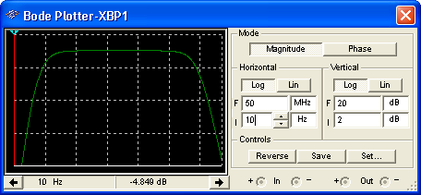
Summary of BJT Frequency Response Analysis
Total Amplifier-Frequency Response
The overall response can be viewed on the Bode plotter by choosing the appropriate scales. The overall response for the BJT example given previously is shown.

Slide 71
Summary of BJT Frequency Response Analysis
Total Amplifier-Frequency Response
For multistage amplifiers, the individual stages have an effect on the overall response.
In general, with different cutoff frequencies, the dominant lower cutoff frequency is equal to the highest f_{cl}; the dominant upper critical frequency is equal to lowest f_{cu}.
When the critical frequencies for multistage amplifiers are equal, the lower critical frequency is higher than any one as given by
and the upper critical frequency is given by

Slide 72

Quiz
1. For a CE amplifier, the emitter bypass capacitor affects the
a. low-frequency response
b. high-frequency response
c. both of the above
d. none of the above

Slide 73
Quiz
2. For a CS amplifier, the gate-drain capacitance affects the
a. low-frequency response
b. high-frequency response
c. both of the above
d. none of the above

Slide 74
Quiz
3. For an inverting amplifier, the Miller effect causes the equivalent capacitance to ground to appear
a. smaller for both C_{in} and C_{out}
b. smaller for C_{in} and larger for C_{out}
c. larger for C_{in} and smaller for C_{out}
d. larger for both C_{in} and C_{out}

Slide 75
Quiz
4. For the CE amplifier shown, the output low-frequency response is determined by
a. (R_{C}||R_{L}) C₃
b. (R_{C}||R_{L}) + C₃
c. (R_{C}+R_{L}) C₃
d. (R_{C}+R_{L}) + C₃

Slide 76
Quiz
5. For the CE amplifier shown, the resistor that is not part of the RC charge and discharge path for (C₂) is
a. R₁
b. R₂
c. R_{C}
d. R_{E}

Slide 77
Quiz
6. The decibel is a ratio of two powers; for this reason the measurement unit is
a. the volt
b. the watt
c. the volt-amp
d. dimensionless

Slide 78
Quiz
7. At the cutoff frequency for an amplifier, the power output compared to the midband power output is
a. −2 dB
b. −3 dB
c. +2 dB
d. +3 dB

Slide 79
Quiz
8. The effect of an unbypassed emitter resistor on the upper cutoff frequency in a CE amplifier is
a. to increase f_{cu}
b. to decrease f_{cu}
c. no effect

Slide 80
Quiz
9. The y-axis of a Bode Plot is used for the
a. frequency scale
b. power scale
c. voltage scale
d. decibel scale

Slide 81
Quiz
10. The term bandwidth refers to those frequencies
a. between the lower and upper critical frequencies
b. above the upper critical frequency
c. below the lower critical frequency
d. none of the above

Slide 82
Quiz
Answers:
1. a
2. b
3. d
4. c
5. c
6. d
7. b
8. b
9. d
10. a

Slide 83
Thank you

